Slide 1
Case Study:
Sleep Habits
Sleep habit takeaways from 2013-2016

Slide 2
Problem
Solution

Slide 3
Analytical Goals
Quantify the average hours of sleep for each year, quarter, month and day of the week.
Determine which month and which day of the week have the highest sleep quality.
Determine if the quality of sleep is better during the weekends or the weekdays.

Slide 4
About the data
The data was collected
Weekend nights were defined as Friday and Saturday nights.
Data Limitations
Data was only collected when the user was wearing the fitness tracker.
Not all sleep events were captured.
Detailed sleep phases were not captured from 1/1/2013 to 1/14/2014
These dates were not included in the detailed sleep analysis

Slide 6
Average Sleep Duration

Slide 7
Sleep Quality:
Month

Slide 9
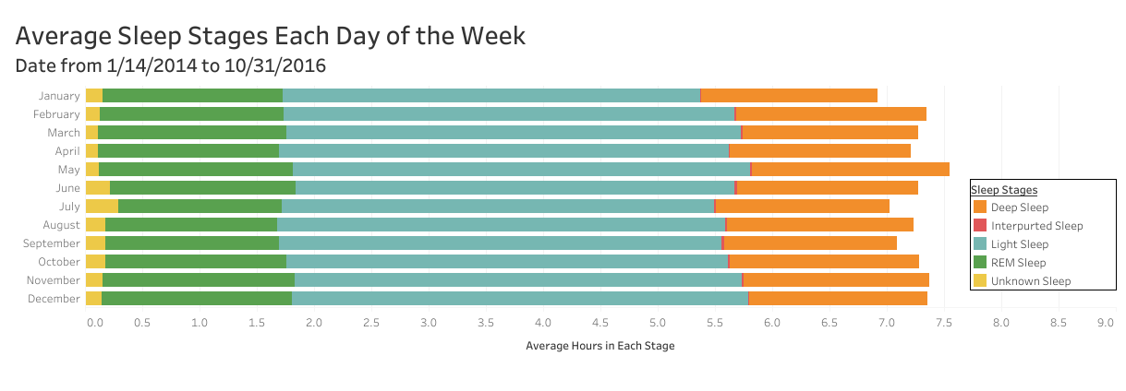
Sleep Quality:
Day of the Week

Slide 10
Recommendations

Slide 11
Additional Details - Sleep Duration Statistics

